Slide 1

Address Translation
PASS
CS532: OS Foundations
Lab Assignment
Email: chitram2@pdx.edu

Slide 2
Instructions: Make a copy of this document, move your copy to your submissions folder and fill the document with your responses. Use the space on each slide to show your responses, and add additional slides as needed.
When ready for grading: complete the lab assignment submission form and include a link to your filled document

Slide 3
paging-linear-translate.py
Find the paging-linear-translate.py program within the vm-paging sub-directory of your ostep-homework directory. This program will help you practice doing address translations from virtual to physical addresses for a single-level page table Operating System.
Read the README.md file in the sub-directory and run the program with the --help switch to learn more about its functionality.

Slide 4
1. Use the simulator to study how linear page tables change size given different parameters. Compute the size of linear page tables as different parameters change. Some suggested inputs are below; by using the -v flag, you can see how many page-table entries are filled. First, to understand how linear page table size changes as the address space grows, run with these flags:
-P 1k -a 1m -p 512m -v -n 0
-P 1k -a 2m -p 512m -v -n 0
-P 1k -a 4m -p 512m -v -n 0

Slide 5
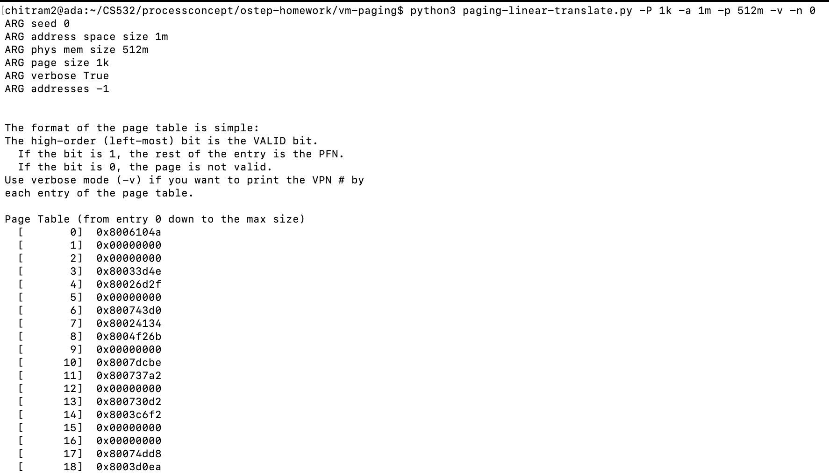
-P 1k -a 1m -p 512m -v -n 0

Slide 6
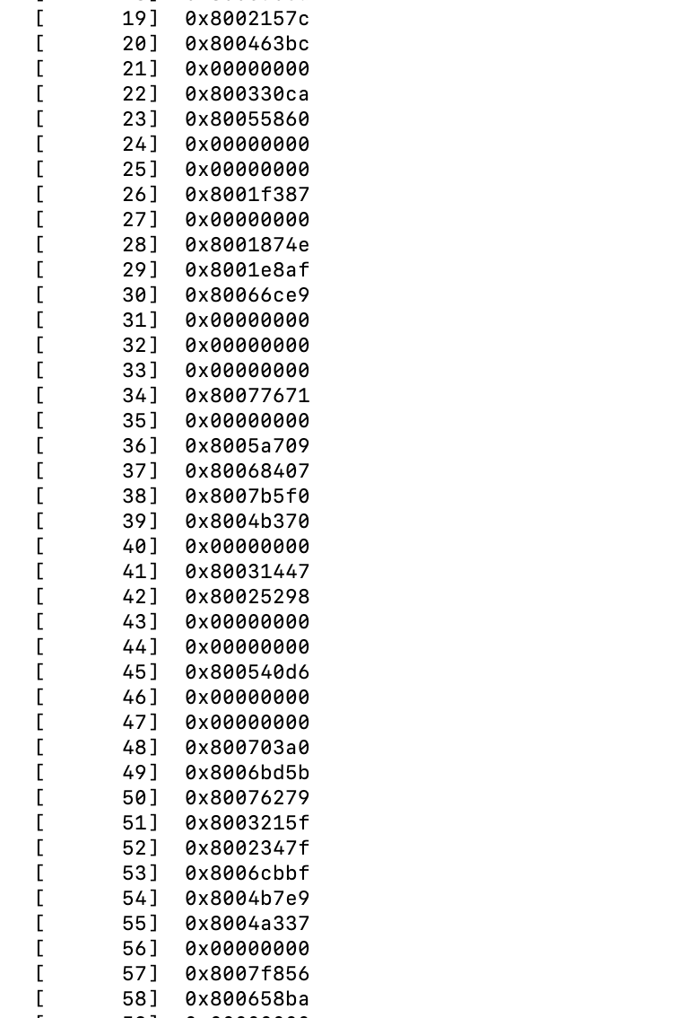

Slide 7
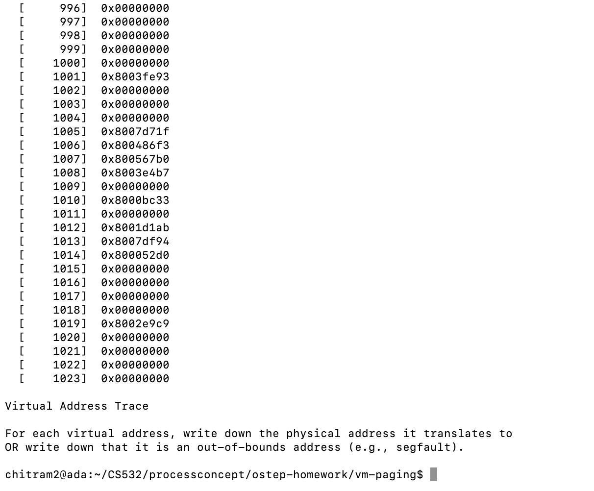

Slide 8
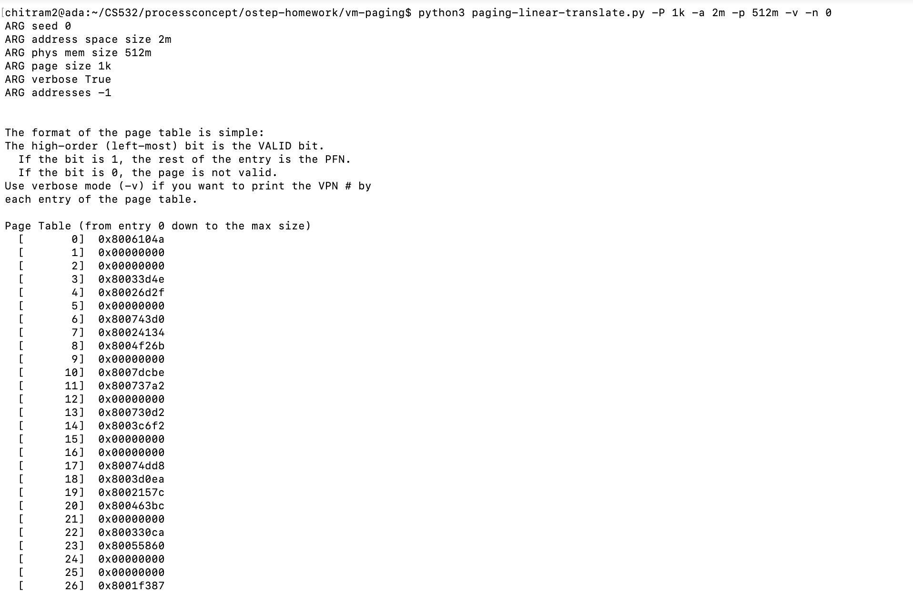
b) -P 1k -a 2m -p 512m -v -n 0

Slide 9
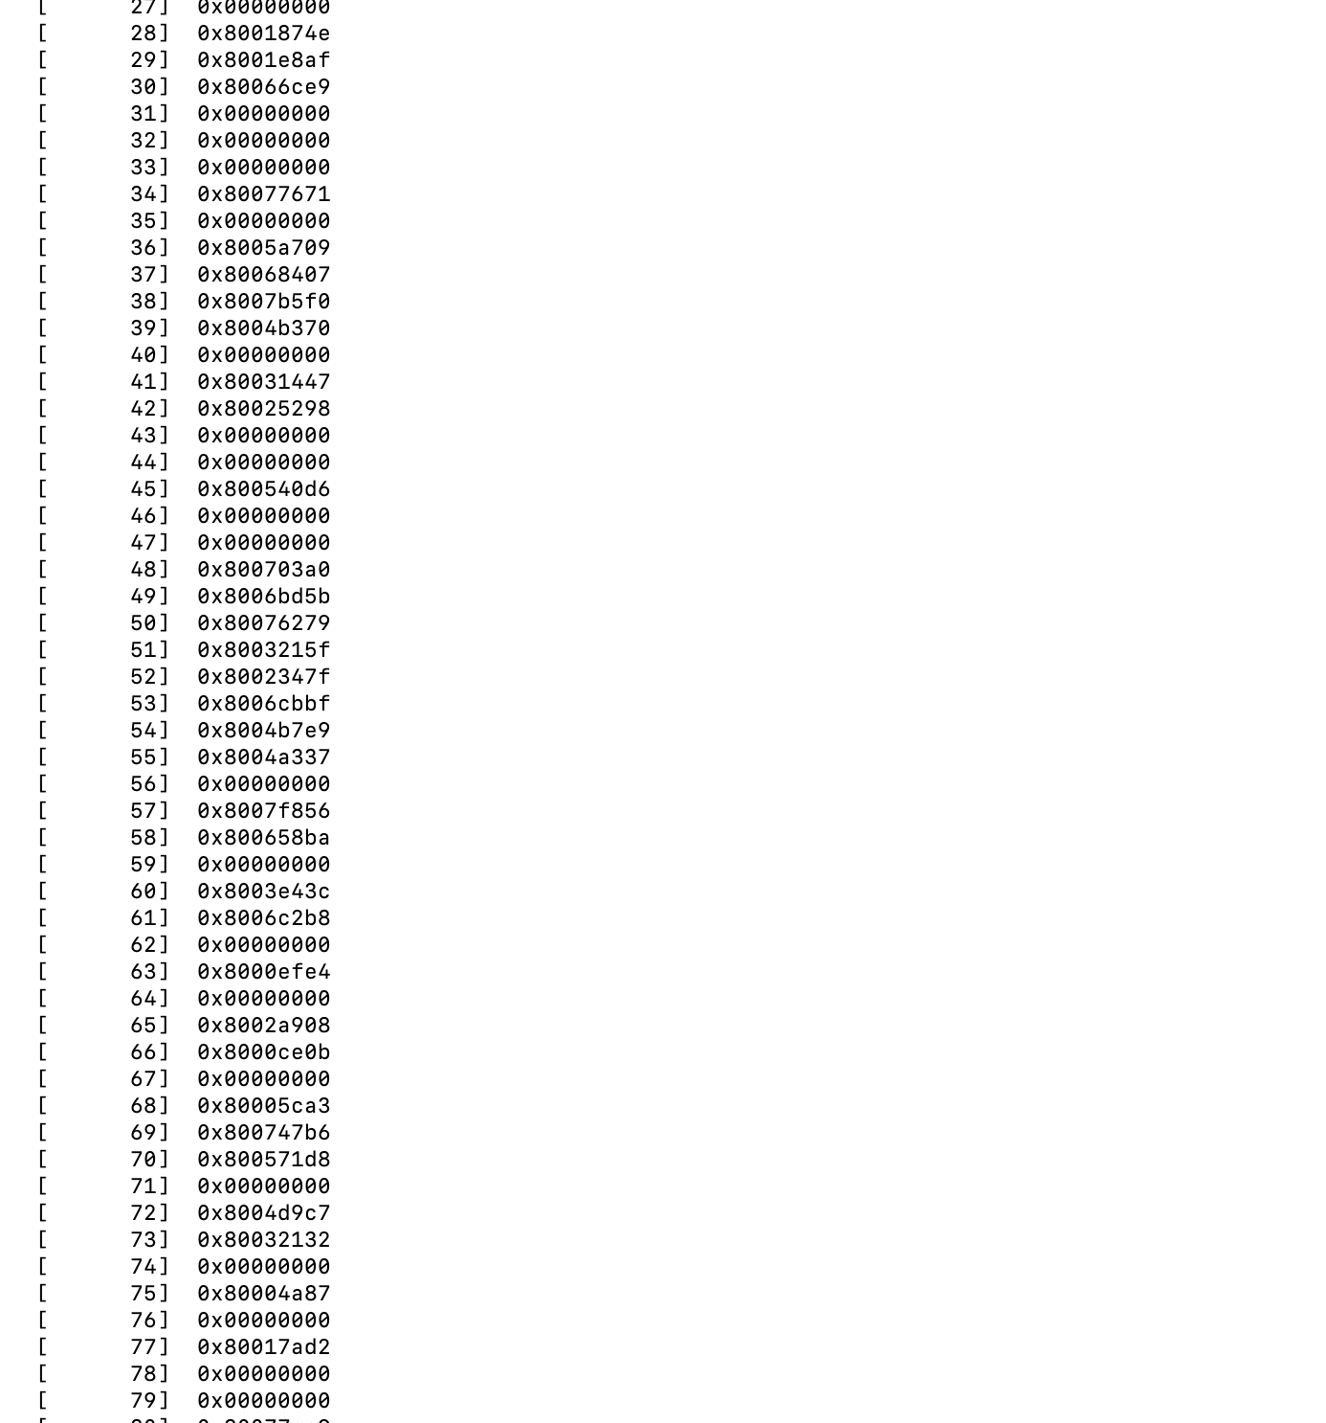

Slide 10
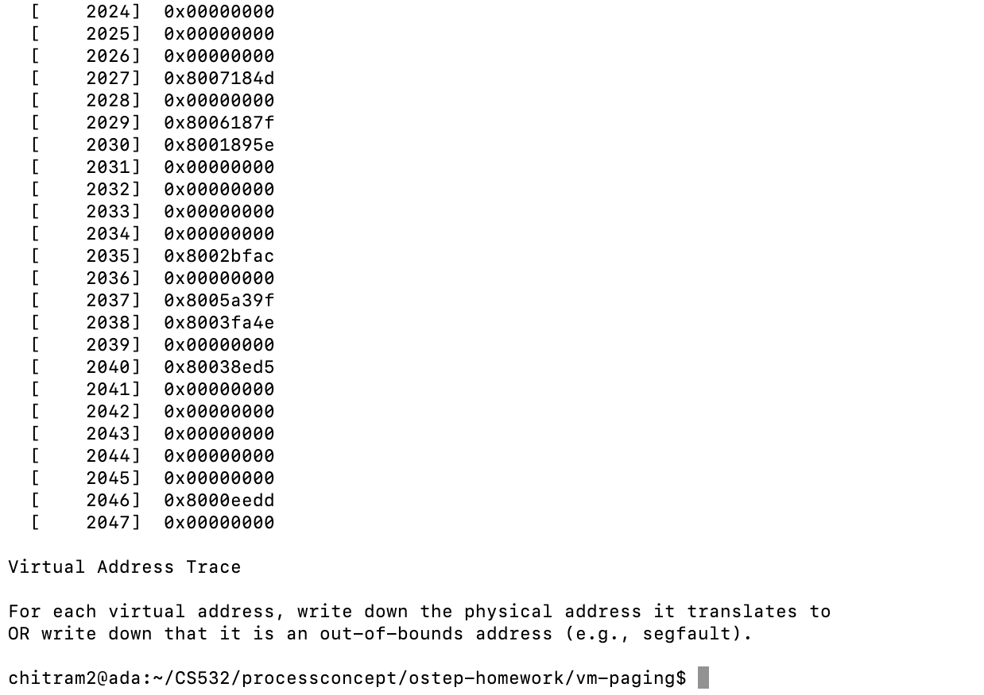

Slide 11
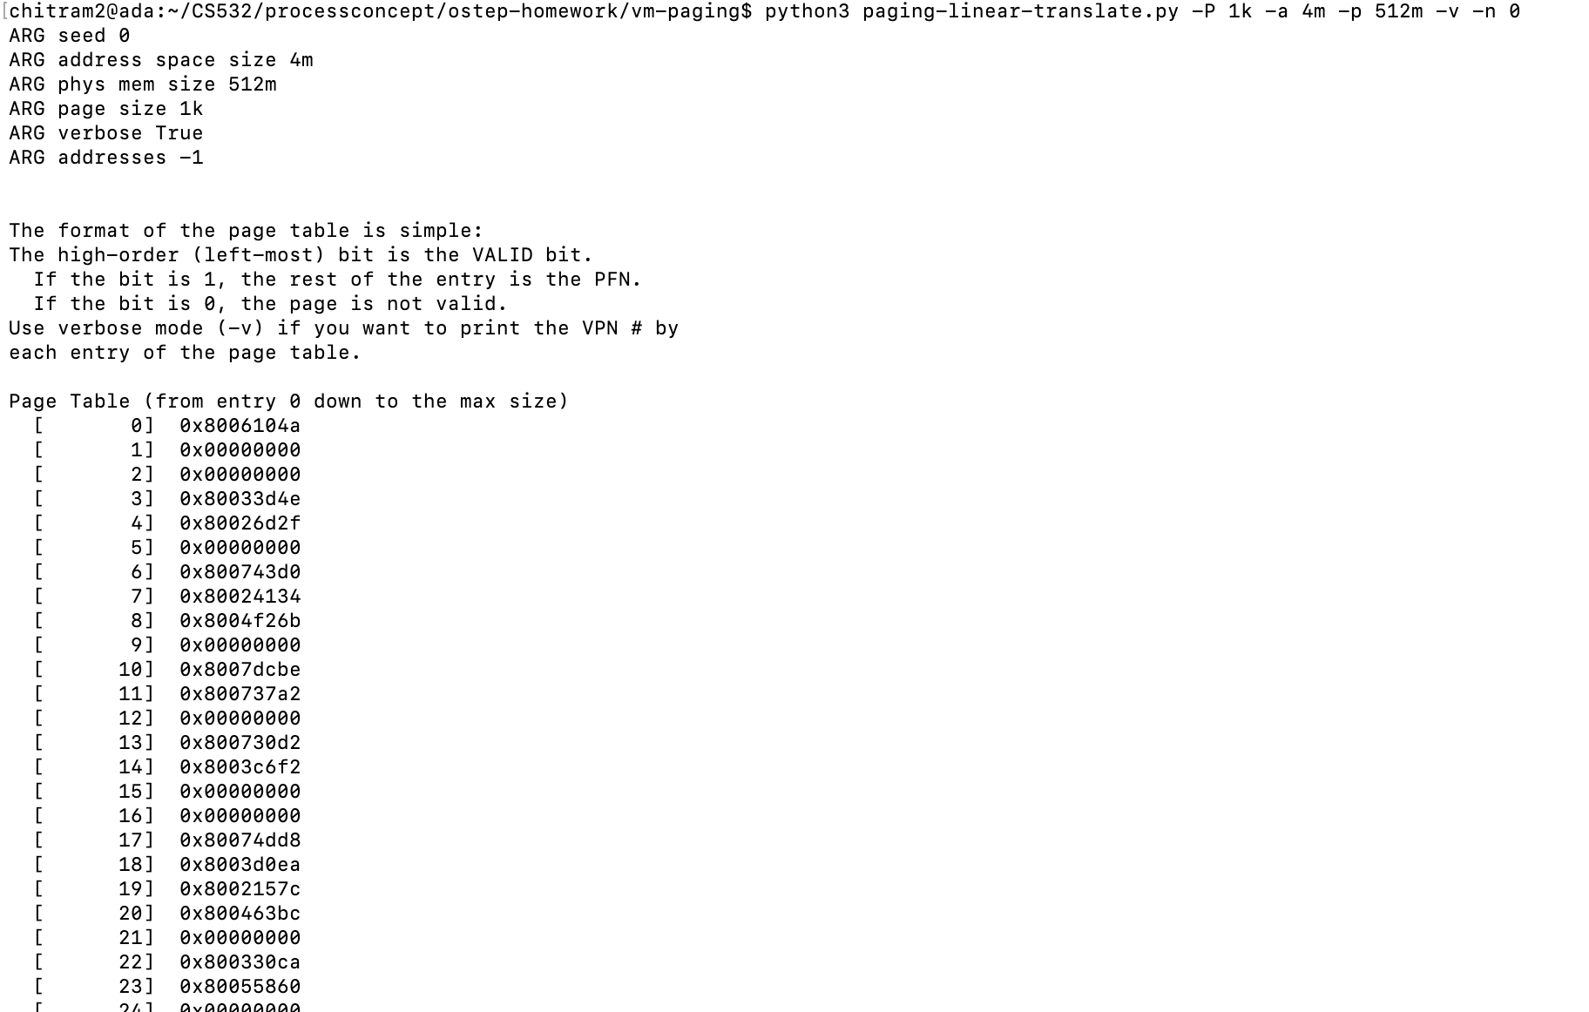
c) -P 1k -a 4m -p 512m -v -n 0

Slide 12
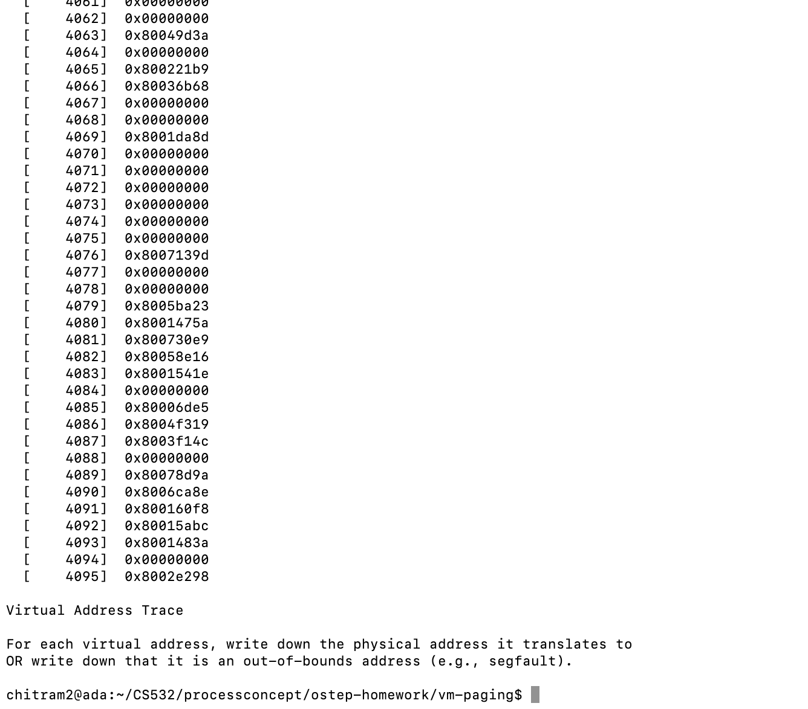

Slide 13
1. (cont)
Then, to understand how linear page table size changes as page size grows, run with each of these parameter settings:
-P 1k -a 1m -p 512m -v -n 0
-P 2k -a 1m -p 512m -v -n 0
-P 4k -a 1m -p 512m -v -n 0

Slide 14
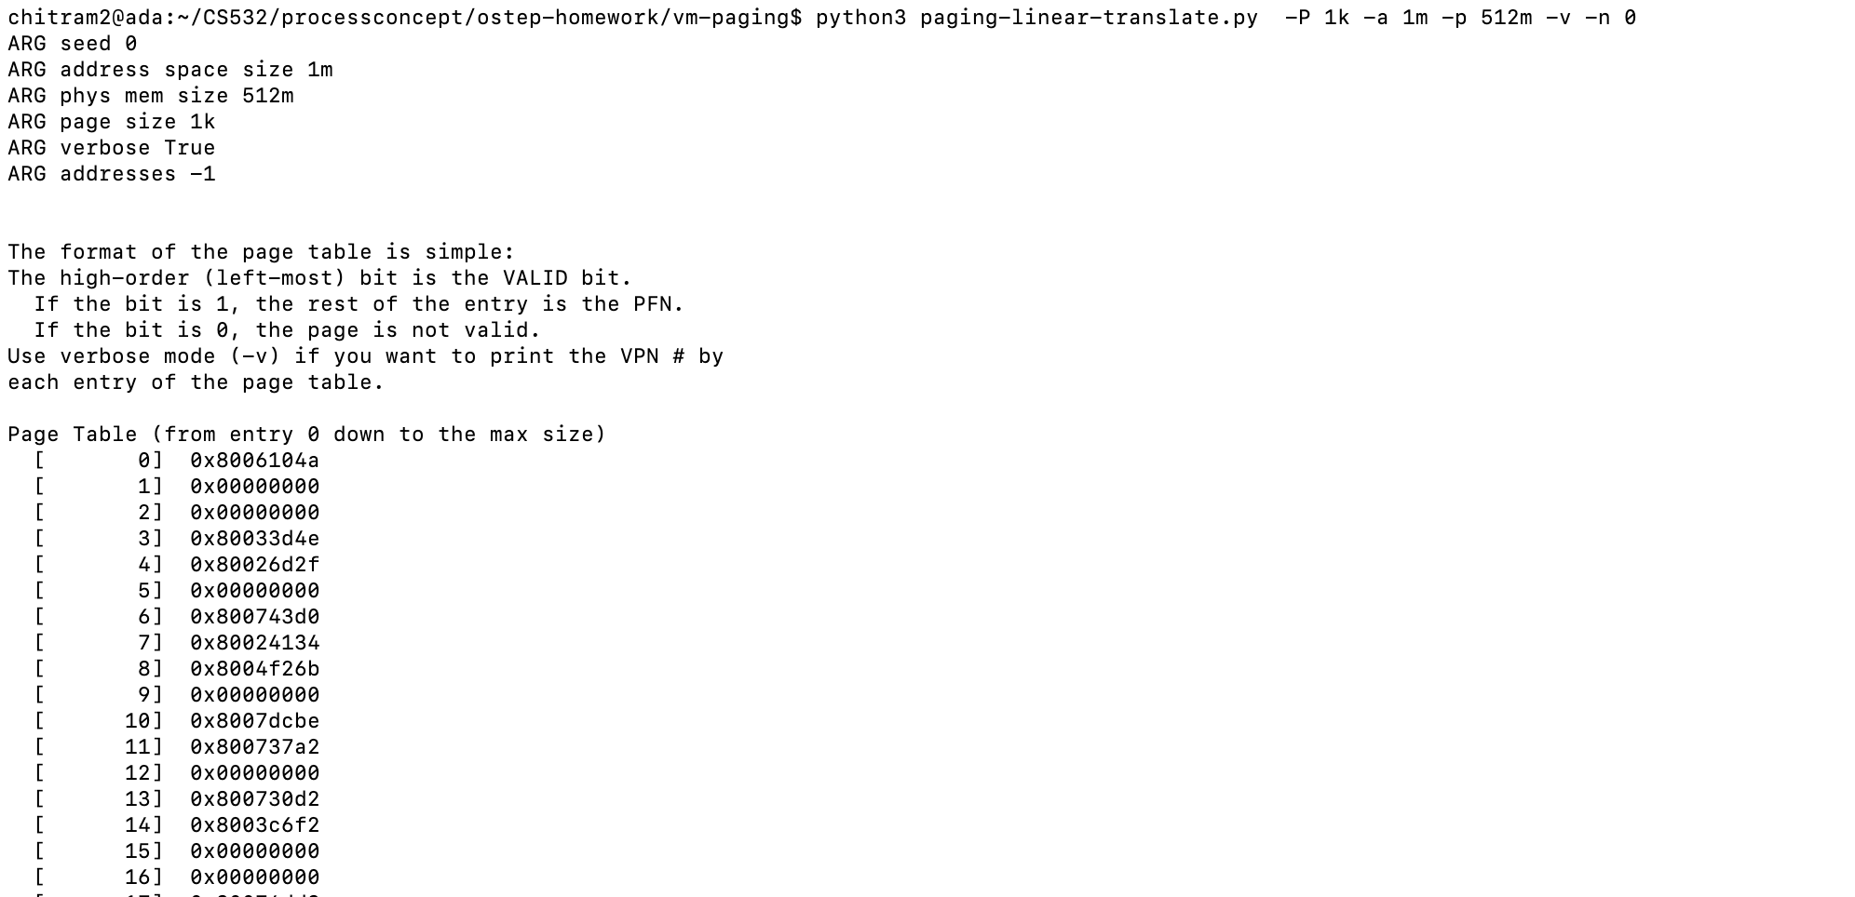
a)-P 1k -a 1m -p 512m -v -n 0

Slide 15
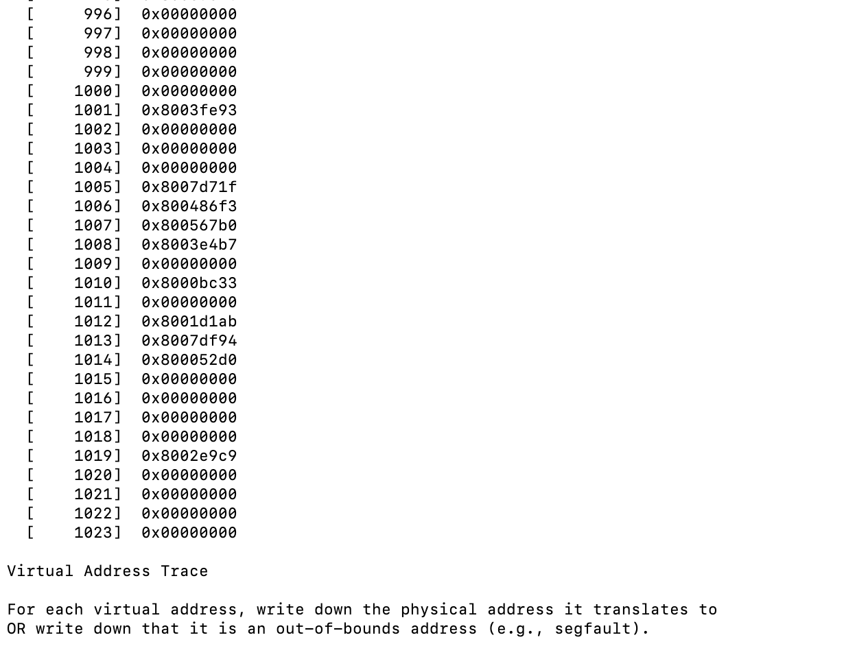

Slide 16
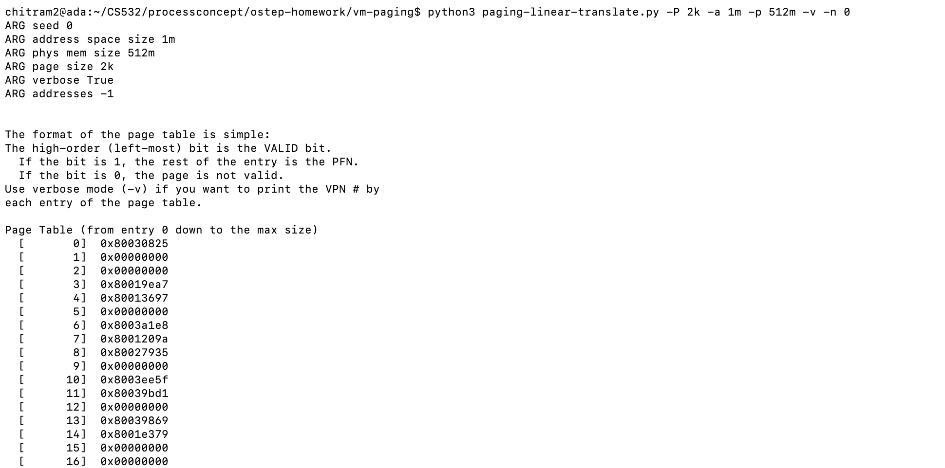
b) -P 2k -a 1m -p 512m -v -n 0

Slide 17
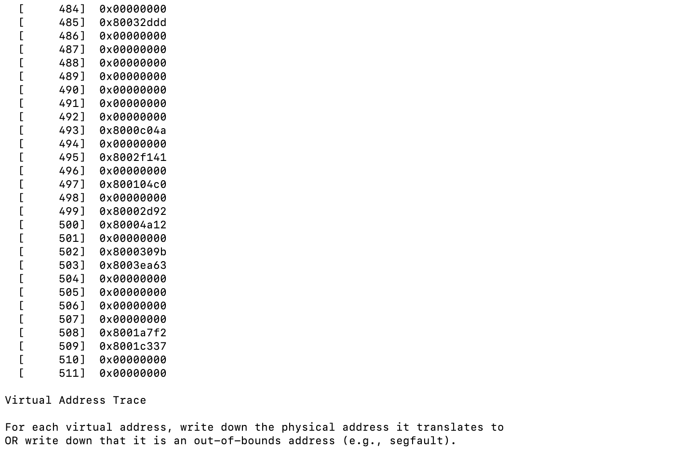

Slide 18
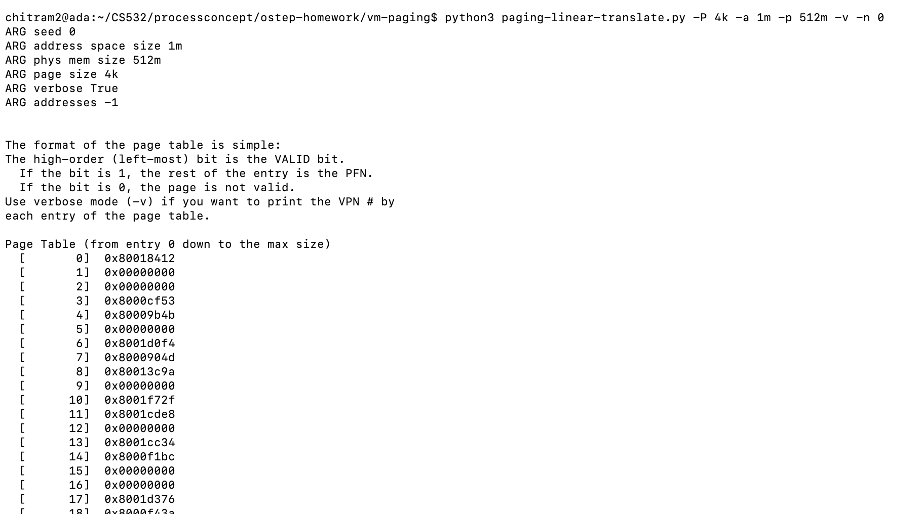
c)-P 4k -a 1m -p 512m -v -n 0

Slide 19
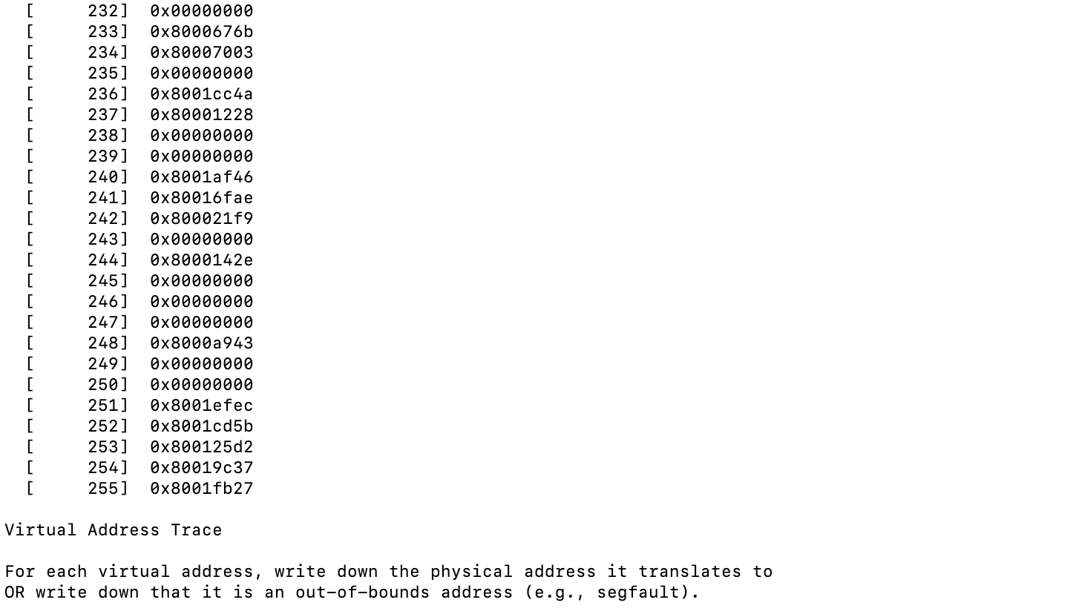

Slide 20
1. (cont)
A. How does page-table size change as the address space grows? Is it a linear relationship?
Page table size increases as the address space grows because we needs more pages to cover the whole address space. It is a linear directly proportional relationship.
B. How does page-table size change as the system page size grows? Is it a linear relationship?
Page table size decreases as the system page size grows because we needs less pages to cover the whole address space. But, It is a not a linear relationship as seen in the following graph.

Slide 21
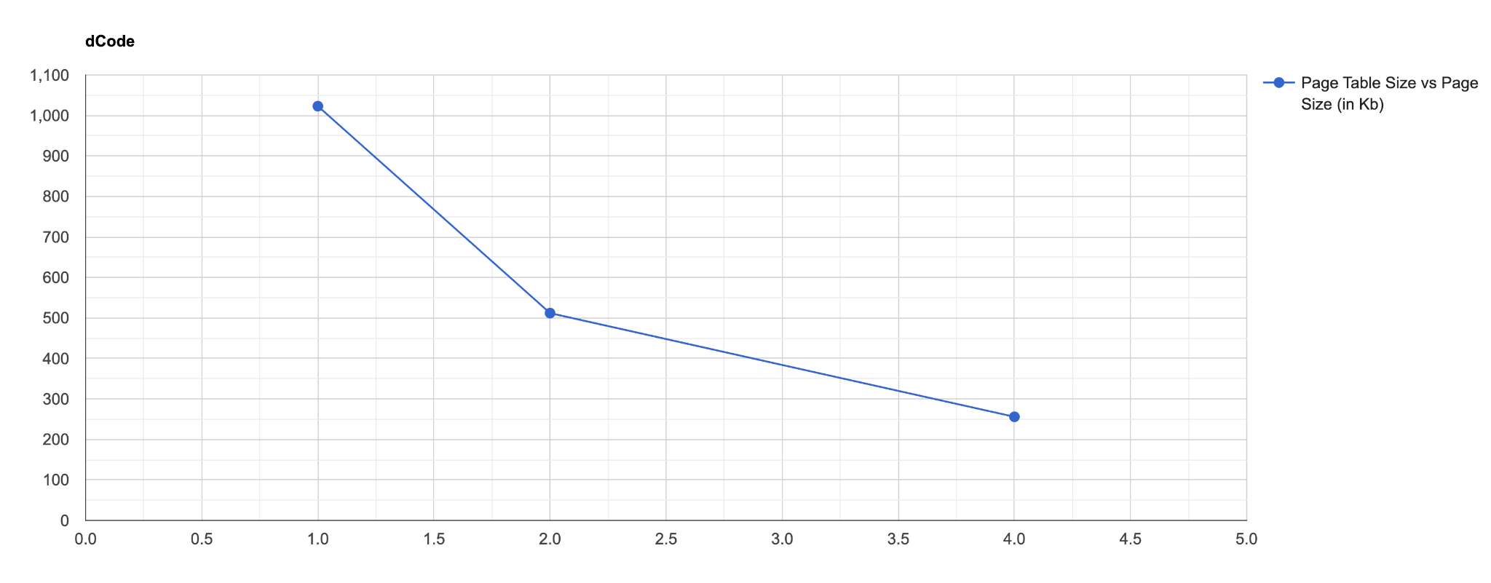
Page table size vs Page Size (Kb)
Y axis - page table size; x axis - page size (kb)

Slide 22
1. (cont)
C. It's nice that we can make the page table smaller by increasing the page size, but why not use big pages in general?
We should not use really big pages in general because it would be a lot of waste of memory. Because, most processes use very little memory.

Slide 23
2. Now let’s do some translations. Start with some small examples, and change the number of pages that are allocated to the address space with the -u flag.
For example:
-P 1k -a 16k -p 32k -v -u 0
-P 1k -a 16k -p 32k -v -u 25
-P 1k -a 16k -p 32k -v -u 50
-P 1k -a 16k -p 32k -v -u 75
-P 1k -a 16k -p 32k -v -u 100

Slide 24
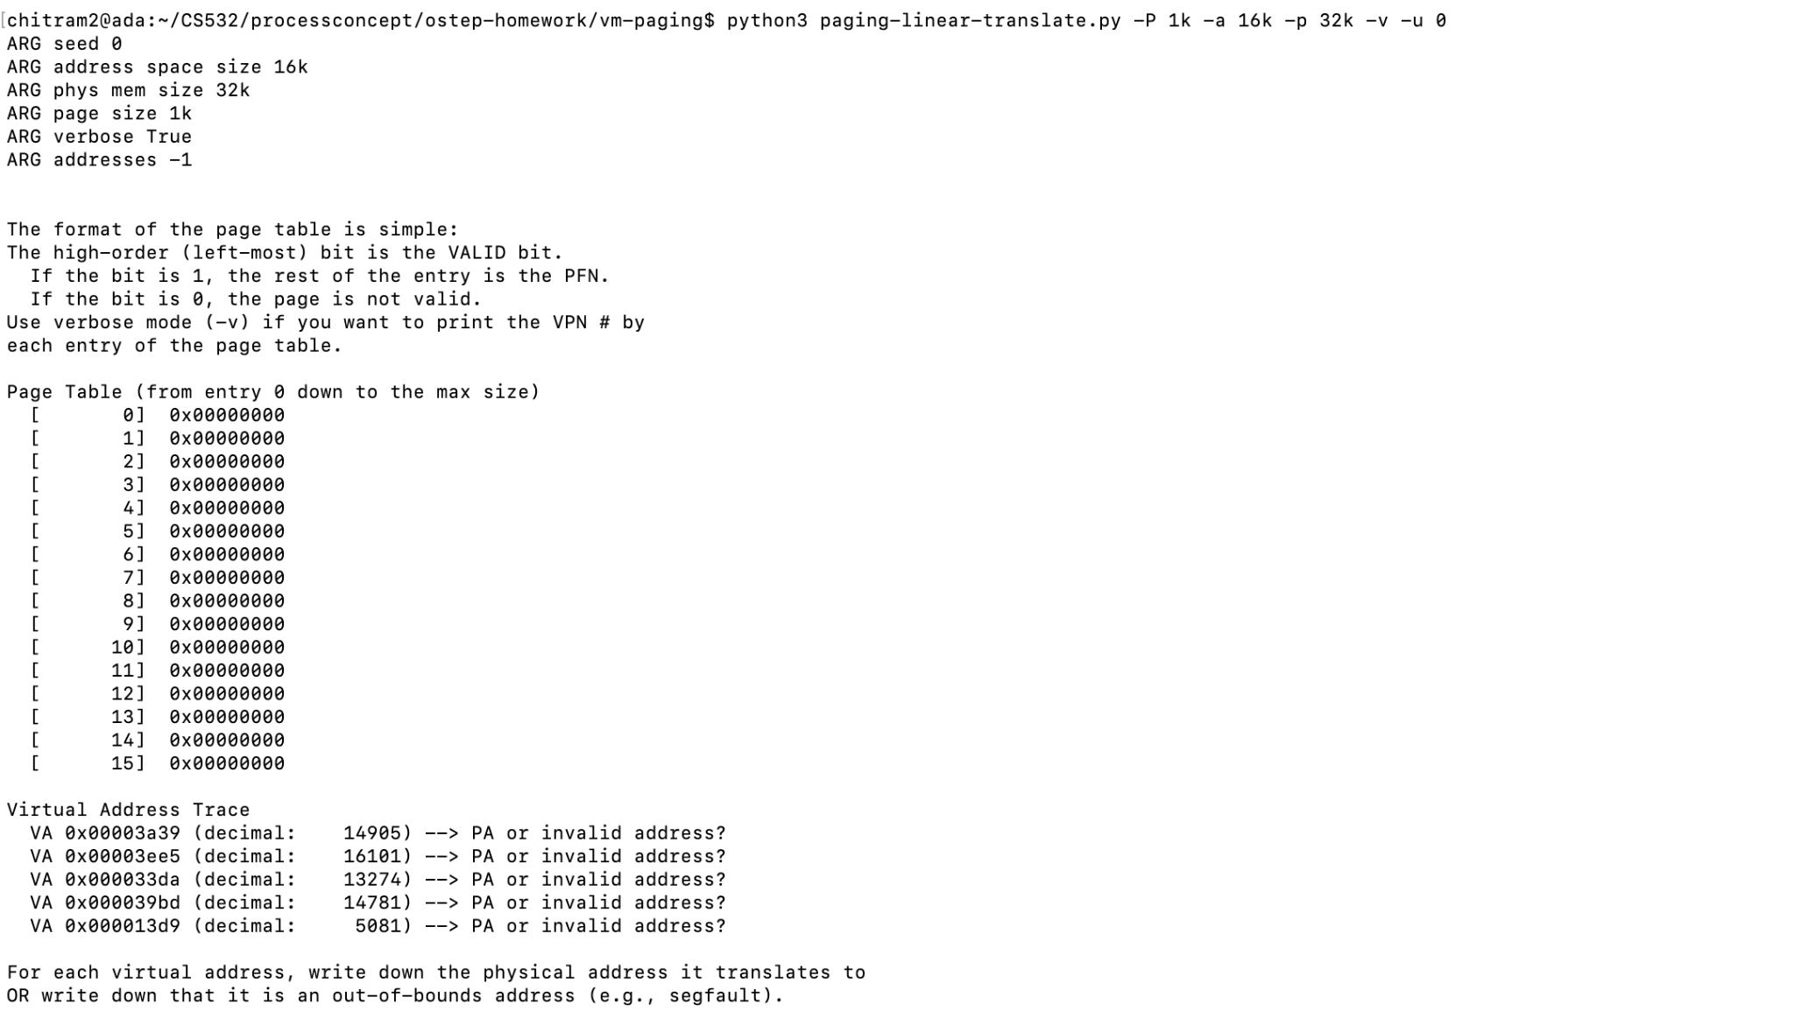
a)-P 1k -a 16k -p 32k -v -u 0

Slide 25
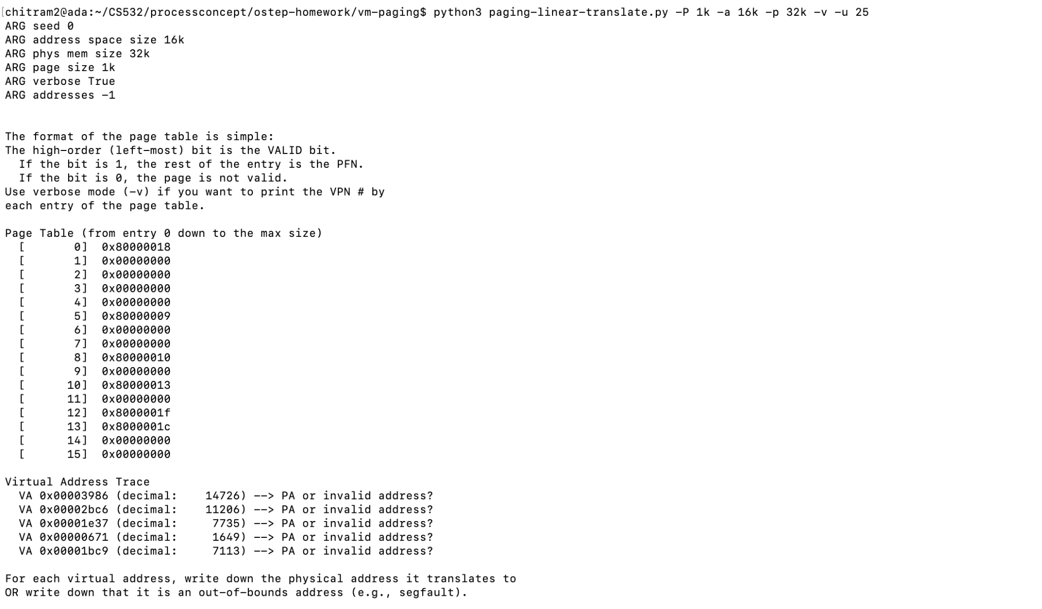
b) -P 1k -a 16k -p 32k -v -u 25

Slide 26
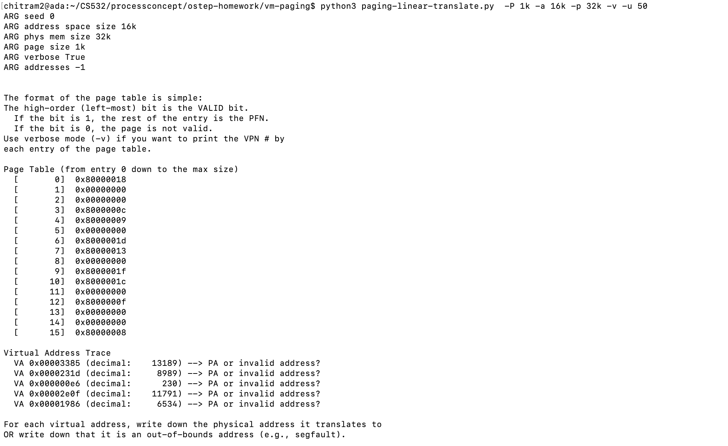
C) -P 1k -a 16k -p 32k -v -u 50

Slide 27
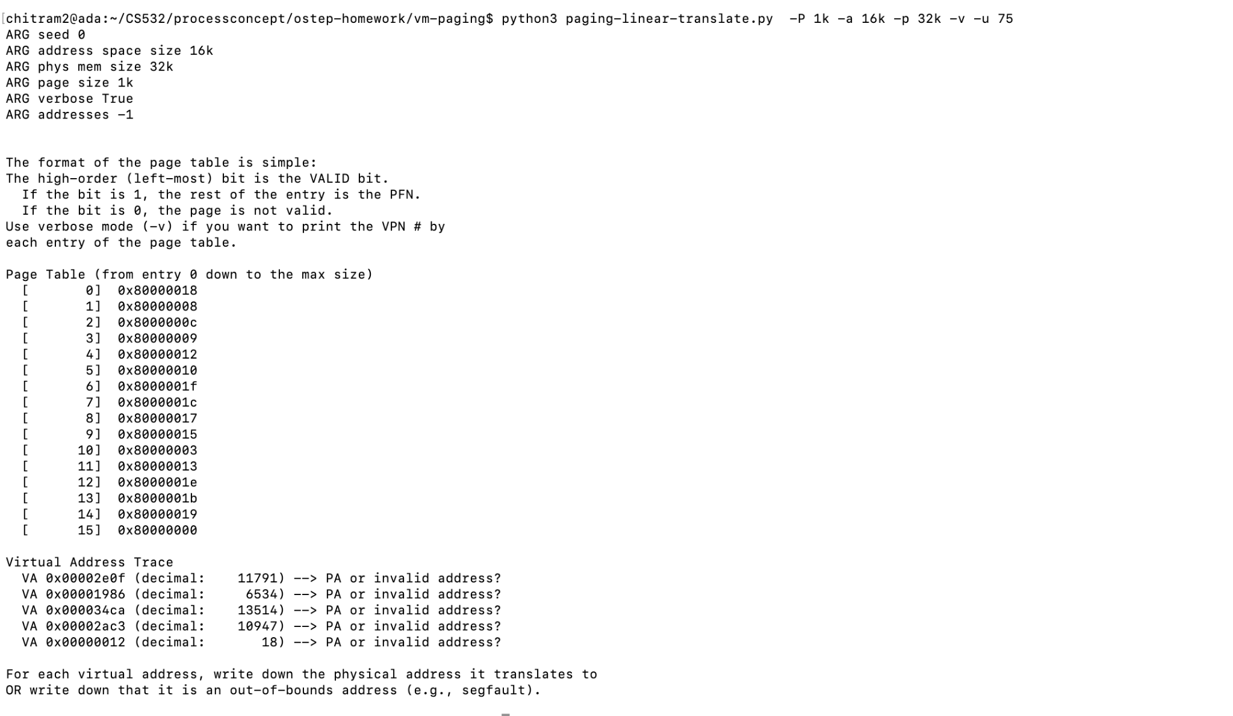
d) -P 1k -a 16k -p 32k -v -u 75

Slide 28
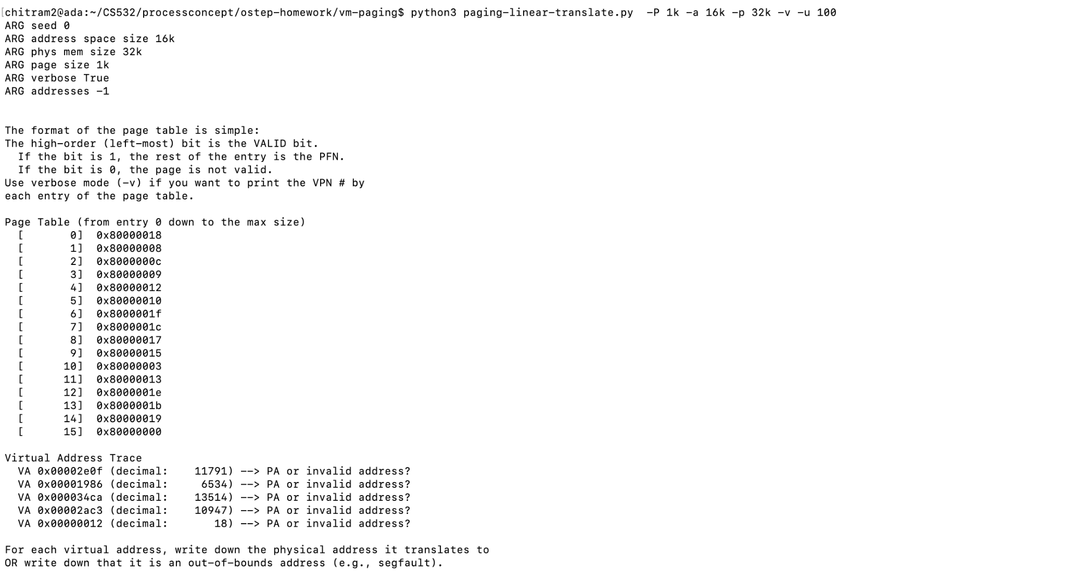
e)-P 1k -a 16k -p 32k -v -u 100

Slide 29
2. (cont) What happens as you increase the percentage of pages that are allocated in each address space?
1.Address space is not used (not filled). That’s why every memory access failed to succeed.
2.Only VA 0x2bc6 is valid.
i.As address space is 16KB so we would have 14bits in total. However, our page size is 1kb so we need 10 bits to move around in our page. So, the other 4 bits would be used as index to our page table.
ii.The binary of 0x2bc6 is 10 1011 1100 0110
iii.So, the VPN is 1010 mean the value of 10th index of Page Table is PPN
iv.The Offset is 11 1100 0110
v.By Looking into page table we get 0x13 at 10th index.
a.However, we have to left shift it 10 times (number of offset bits)
b.So, it becomes 0100 1100 0000 0000
vi.Then, we have to OR this with out offset (0011 1100 0110 OR 0100 1100 0000 0000)
vii.It finally becomes 0x4FC6
As, the percentage of pages that are allocated or usage of address space is increased more and more memory access operations become valid however free space decreases

Slide 30
3. Next, try some different random seeds, and some different (and sometimes quite crazy) address-space parameters, for variety:
-P 8 -a 32 -p 1024 -v -s 1
-P 8k -a 32k -p 1m -v -s 2
-P 1m -a 256m -p 512m -v -s 3
Which of these parameter combinations are unrealistic? Why?

Slide 31
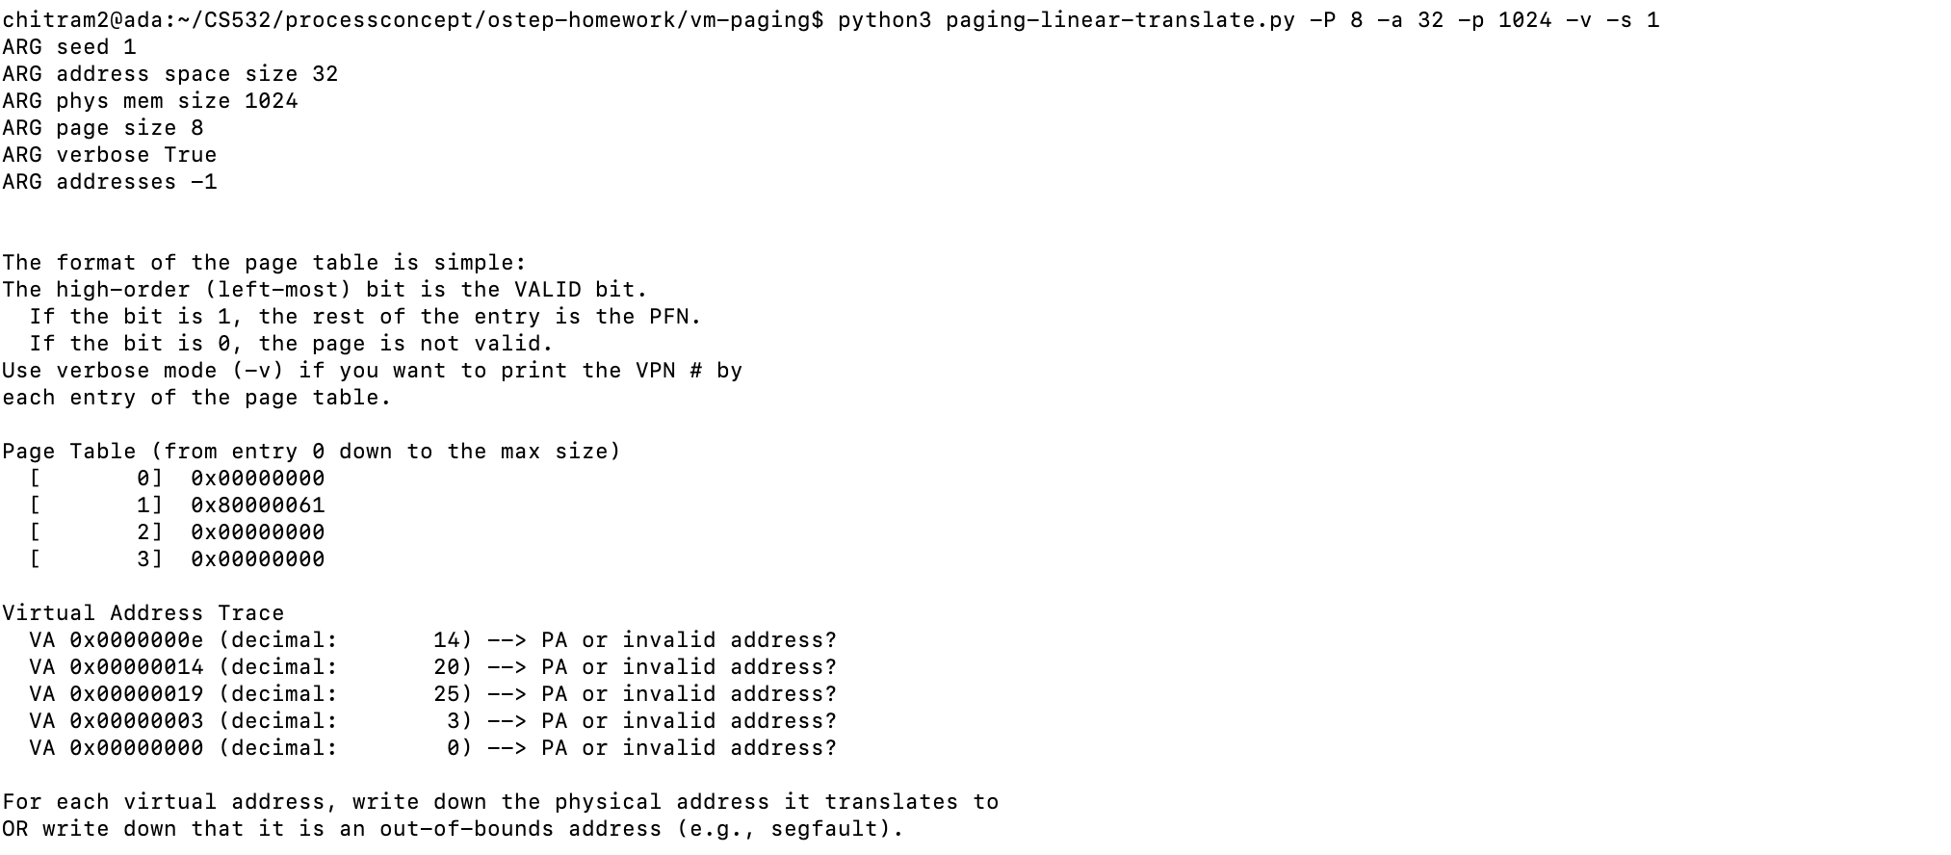
-P 8 -a 32 -p 1024 -v -s 1

Slide 32
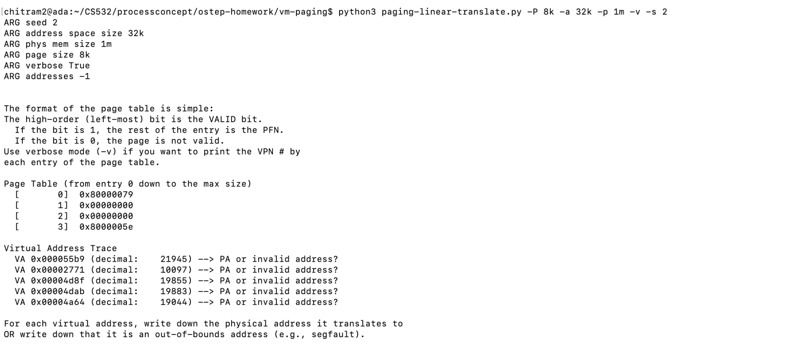
b) -P 8k -a 32k -p 1m -v -s 2

Slide 33
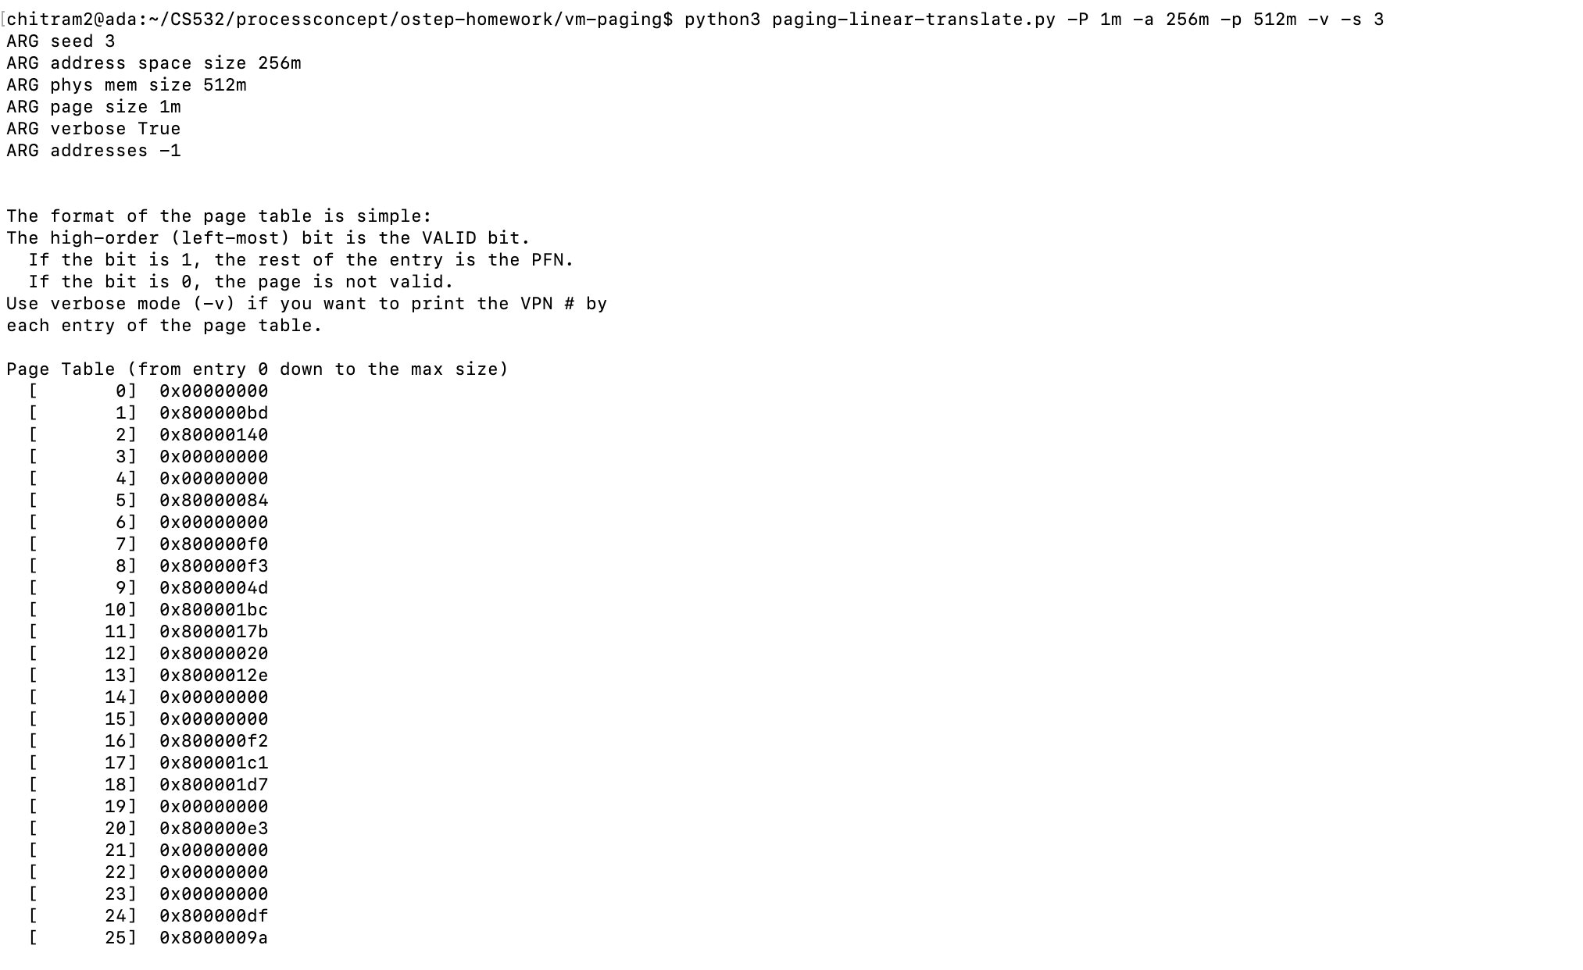
c)-P 1m -a 256m -p 512m -v -s 3

Slide 34
Which of these parameter combinations are unrealistic? Why?
The first one is unrealistic as it presents too small sizes of the parameters required to present a viable page table.

Slide 35
4. Use the program to try out some other problems of your own choice.
Can you find the limits of where the program doesn’t work anymore? For example, what happens if the address-space size is bigger than physical memory?

Slide 36
When tried with different other parameters, It won't work when
1.page size is greater than address-space.
2.address space size is greater than the physical memory.
3.physical memory size is not multiple of page size.
4.address space is not multiple of page size.
5.page size is negative.
6.physical memory is negative.
7.address space is negative.

